Slide 1
Modern Fuzzing of C/C++ projects
Max Moroz
Google

Slide 2
Bio
Google Chrome Security team, Bugs--
BalalaikaCr3w, LC↯BC
CTF, BugBounty, etc

Slide 3
Agenda
TODO: write agenda
???
Slides
Workshop

Slide 4
My first year in university
$ ./fact
Enter n to compute n! : 5
5! = 120

Slide 5
My first year in university
$ ./fact
Enter n to compute n! : 5
5! = 120
$ ./fact
Enter n to compute n! : AAAAAAAAAAAAAAAAAAAAAAAAAAAAAAAAAAAAAAAAAAAAAAAAAAAAAAAAAAAAAAAAAAAAAAAAAAAAAAAAAAAA
Segmentation fault (core dumped)

Slide 6

My first year in university
$ ./fact
Enter n to compute n! : 5
5! = 120
$ ./fact
Enter n to compute n! : AAAAAAAAAAAAAAAAAAAAAAAAAAAAAAAAAAAAAAAAAAAAAAAAAAAAAAAAAAAAAAAAAAAAAAAAAAAAAAAAAAAA
Segmentation fault (core dumped)
$ ./fact
Enter n to compute n! : 12345678990
-539222898! = 1

Slide 7
Fuzzing

Slide 8
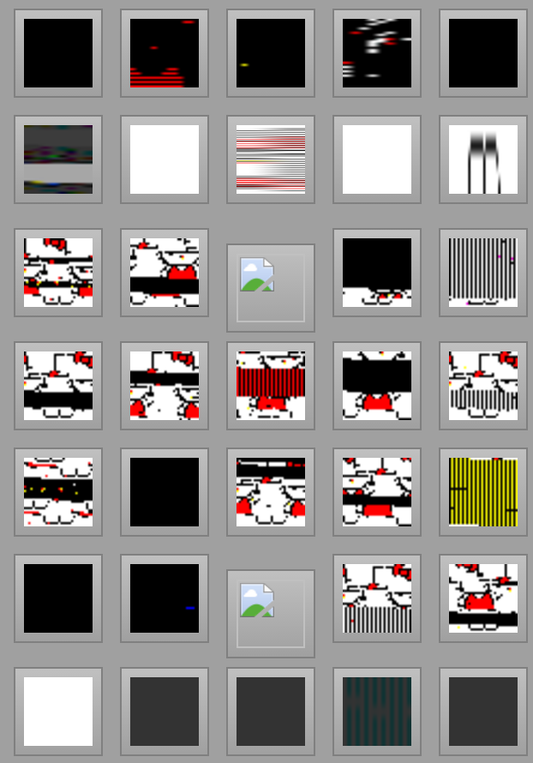
Fuzzing
A software testing technique, often automated or semi-automated, that involves passing invalid, unexpected or random input to a program and monitor result for crashes, failed assertions, races, leaks, etc.

Slide 9
Unit testing vs. Fuzz testing
 | Unit Testing | Old Fuzzing
Test small parts of code | ✔ | X
Can be automated | ✔ | ✔
Regression testing | ✔ | ✔ / X
Easy to write | ✔ | X
Looking for new bugs | ✔ / X | ✔✔✔
Looking for vulnerabilities | X | ✔

Slide 10
Unit testing vs. Fuzz testing
 | Unit Testing | Old Fuzzing | Modern Fuzzing
Test small parts of code | ✔ | X | ✔
Can be automated | ✔ | ✔ | ✔
Regression testing | ✔ | ✔ / X | ✔
Easy to write | ✔ | X | ✔
Looking for new bugs | ✔ / X | ✔✔✔ | ✔✔✔✔✔✔
Looking for vulnerabilities | X | ✔ | ✔

Slide 11
Vocabulary
Target
Consumes an array of bytes
Calls the code we want to test
Fuzzer
A tool that feed the target with different random inputs
Corpus
A set of valid & invalid inputs for the target
Collected manually, by fuzzing, or by crawling

Slide 12
Fuzzer types
Overview

Slide 13
Fuzzer types
Example
https://bugs.webkit.org/show_bug.cgi?id=60831
<script>
document.body = document.createElement(‘iframe’);
</script>
Generation Based
Generate from scratch with no prior state

Slide 14
Fuzzer types
Example
crbug.com/552046
--- orig.pdf
+++ crash.pdf
@@ -57,7 +57,7 @@
/DecodeParms [null 8 0 R]
/Type /XObject
/Width 1760
-/Filter [/FlateDecode /DCTDecode]
+/Filter [/JBIG2Decode /DCTDecode]
/Height 1248
/Length 2277
Mutation Based
Mutate existing state based on some rules

Slide 15
Fuzzer types
Example
crbug.com/575205
SELECT'\xef(\xfb;DS\x1aLEETABL\xfeES'REGEXP';0\t\tC LE|A*(\xc8*.+!*)*h*00\x0b$T''&'
Evolutionary
Generation or mutation based or both, in-process with code coverage feedback

Slide 16
Fuzzing in the past
Old school fuzzing

Slide 17
Routine
Generate an HTML page

Slide 18
Routine
Generate an HTML page
Write it to the disk

Slide 19
Routine
Generate an HTML page
Write it to the disk
Launch browser

Slide 20
Routine
Generate an HTML page
Write it to the disk
Launch browser
Open the page or serve it over HTTP

Slide 21
Routine
Generate an HTML page
Write it to the disk
Launch browser
Open the page or serve it over HTTP
Check if the browser crashed

Slide 22
Routine
Generate an HTML page
Write it to the disk
Launch browser
Open the page or serve it over HTTP
Check if the browser crashed
Close the browser

Slide 23
Let’s write some code
Lesson 02

Slide 24

No coverage

Slide 25
Problems of old school fuzzing
Large search space
Cannot fuzz specific function
Hard to fuzz network protocols
Speed of regular fuzzers (html, css, dom, etc mutators)

Slide 26
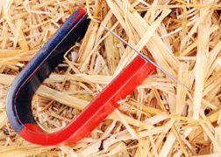
Coverage

Slide 27
Goals
More focused fuzzing
Faster fuzzing
Smarter fuzzing
Easier fuzzer writing

Slide 28
LibFuzzer
New school fuzzing

Slide 29
LibFuzzer
In-process, in-memory

Slide 30
LibFuzzer
In-process, in-memory
Guided fuzz testing

Slide 31
LibFuzzer
In-process, in-memory
Guided fuzz testing
Very effective at a function / protocol level

Slide 32
LibFuzzer
In-process, in-memory
Guided fuzz testing
Very effective at a function / protocol level
1000x faster

Slide 33
LibFuzzer
In-process, in-memory
Guided fuzz testing
Very effective at a function / protocol level
1000x faster
It’s easy to write a libFuzzer-based fuzzer

Slide 34
LibFuzzer
In-process, in-memory
Guided fuzz testing
Very effective at a function / protocol level
1000x faster
It’s easy to write a libFuzzer-based fuzzer
Can be checked along with unit-tests

Slide 35

Coverage-guided fuzz testing

Slide 36
Memory Tools
How to see the invisible

Slide 37
Memory Tools
AddressSanitizer (aka ASan)
Detects use-after-free, buffer overflows (heap, stack, globals), stack-use-after-return, container-overflow
Cpu: 2x, memory 1.5x-3x
MemorySanitizer (aka MSan)
Detects uninitialized memory reads
Cpu: 3x, memory: 2x
Special mode: origins
UndefinedBehaviorSanitizer (aka UBSan)
Detects several classes of bugs (19?), esp on type confusion, signed-integer-overflow, undefined shift, etc.
Cpu: 10-50%
Memory: ~1x (no allocator, no shadow)

Slide 38
Memory tools: example
Container-overflow (ASan):
#include <vector>
#include <assert.h>
typedef long T;
int main() {
std::vector<T> v;
v.push_back(0);
v.push_back(1);
v.push_back(2);
assert(v.capacity() >= 4);
assert(v.size() == 3);
T *p = &v[0];
// Here the memory is accessed inside a heap-allocated buffer
// but outside of the region `[v.begin(), v.end())`.
return p[3]; // OOPS.
}

Slide 39
Let’s write some code
Lessons 03 - 06

Slide 40
How to improve your fuzzer
Dictionaries
Seed corpus
Custom options
Fuzzing of non-raw data arguments
Optimization

Slide 41

Dictionaries

Slide 42
Dictionaries
XML:
" encoding=\"1\""
" a=\"1\""
" href=\"1\""
" standalone=\"no\""
" version=\"1\""
" xml:base=\"1\""
" xml:id=\"1\""
" xml:lang=\"1\""
" xml:space=\"1\""
" xmlns=\"1\""
"&lt;"
"&#1;"
"&a;"
"&#x1;"
"ANY"
"[]"
"CDATA"
":fallback"
":include"
"--"
"EMPTY"
"\"\""
"''"
"ENTITIES"
"ENTITY"
PNG:
header_png="\x89PNG\x0d\x0a\x1a\x0a"
section_IDAT="IDAT"
section_IEND="IEND"
section_IHDR="IHDR"
section_PLTE="PLTE"
section_bKGD="bKGD"
section_cHRM="cHRM"
section_fRAc="fRAc"
section_gAMA="gAMA"
section_gIFg="gIFg"
section_gIFt="gIFt"
section_gIFx="gIFx"
section_hIST="hIST"
section_iCCP="iCCP"
section_iTXt="iTXt"
section_oFFs="oFFs"
section_pCAL="pCAL"
section_pHYs="pHYs"
section_sBIT="sBIT"
section_sCAL="sCAL"
section_sPLT="sPLT"
section_sRGB="sRGB"
section_sTER="sTER"
section_tEXt="tEXt"
section_tIME="tIME"

Slide 43
Dictionary generation
Fuzzer | Dict. size | Corpus, % | Coverage, % | Speed, %
expat_xml_parse_fuzzer | 428 | -3.68 | -2.72 | 1.59
libxml_xml_read_memory_fuzzer | 780 | 30.81 | 41.14 | 24.13
net_ftp_directory_listing_fuzzer | 842 | 1.84 | 1.03 | -16.02
net_http_proxy_client_socket_fuzzer | 2,006 | 303.90 | 26.36 | -0.74
net_http_stream_parser_fuzzer | 2,006 | 259.34 | 31.16 | 3.96
net_url_request_fuzzer | 1,239 | 127.44 | 6.78 | 4.86
net_websocket_frame_parser_fuzzer | 925 | 3.85 | 0.35 | 0.77
pdf_css_fuzzer | 2,037 | -7.56 | -0.22 | -1.79
pdf_xml_fuzzer | 927 | 8.04 | 0.74 | 4.52
sqlite3_prepare_v2_fuzzer | 657 | 370.04 | 201.68 | -11.21
url_parse_fuzzer | 650 | 473.33 | 325.07 | -11.70
v8_script_parser_fuzzer | 1,535 | 25.63 | 2.31 | 9.27
$ chromium/src/testing/libfuzzer/dictionary_generator.py \
--fuzzer PATH_TO_FUZZER_BINARY \
--spec PATH_TO_FORMAT_SPECIFICATION \
--out GENERATED_DICTIONARY.dict

Slide 44
Recommended dictionary
Command: ['<...>/boringssl_read_pem_fuzzer', <...>]
Bot: clusterfuzz-linux-pre-0234
Time ran: 3251.046254
INFO: Seed: 1441206595
#0 READ units: 1166 exec/s: 0
#1167 INITED cov: 204 bits: 366 indir: 16 units: 119 exec/s: 0
#1168 NEW cov: 277 bits: 366 indir: 22 units: 120 exec/s: 0 L: 129 MS: 1 InsertByte-
<...>
#147891067 DONE cov: 278 bits: 370 indir: 22 units: 123 exec/s: 45490
###### Recommended dictionary. ######
"(:(\xe7\x9d/!;!;O" # Uses: 8451959
"-----BEGIN " # Uses: 8454876
###### End of recommended dictionary. ######
Done 147891067 runs in 3251 second(s)
stat::number_of_executed_units: 147891067
stat::average_exec_per_sec: 45490
<...>

Slide 45
Recommended dictionary
Command: ['<...>/net_url_request_fuzzer, <...>]
Bot: clusterfuzz-linux-high-end-pre-0034
Time ran: 3251.478762
Dictionary: 128 entries
INFO: Seed: 964796221
#0 READ units: 10055 exec/s: 0
#128 pulse cov: 5322 bits: 7463 indir: 415 units: 10055 exec/s: 64
<...>
#366810 DONE cov: 12167 bits: 55024 indir: 756 units: 10093 exec/s: 112
###### Recommended dictionary. ######
"blob" # Uses: 3996
"http" # Uses: 2420
"file" # Uses: 1536
"foo" # Uses: 1105
"ntlm" # Uses: 922
###### End of recommended dictionary. ######
<...>

Slide 46
Recommended dictionary
Command: ['<...>/net_parse_cookie_line_fuzzer', <...>]
Bot: clusterfuzz-linux-high-end-pre-0080
Time ran: 3251.114852
INFO: Seed: 1831825350
#0 READ units: 1142 exec/s: 0
#1142 INITED cov: 318 bits: 1041 indir: 35 units: 332 exec/s: 0
#1143 NEW cov: 427 bits: 1041 indir: 41 units: 333 exec/s: 0 L: 29 MS: 1 ChangeByte-
<...>
#6808457 NEW cov: 428 bits: 1045 indir: 41 units: 337 exec/s: 11272 L: 698 MS: 5 ChangeByte-AddFromTempAutoDict-ShuffleBytes-AddFromTempAutoDict-CrossOver- DE: "httponly"-"path"-
<...>
#36643517 DONE cov: 428 bits: 1045 indir: 41 units: 337 exec/s: 11271
###### Recommended dictionary. ######
"httponly" # Uses: 1917525
"path" # Uses: 1942187
###### End of recommended dictionary. ######
<...>

Slide 47
Seed corpus
$ ls testing/libfuzzer/fuzzers/woff2_corpus/
AhemSpaceLigature.woff2 DejaVuSerif.woff2 MEgalopolisExtra.woff2
Ahem.woff2 EzraSIL.woff2 mplus-1p-regular.woff2
DejaVuSerif-webfont.woff2 LinLibertineO.woff2 OpenSans.woff2
tcu-font.woff2

Slide 48
Seed corpus
$ ls testing/libfuzzer/fuzzers/woff2_corpus/
AhemSpaceLigature.woff2 DejaVuSerif.woff2 MEgalopolisExtra.woff2
Ahem.woff2 EzraSIL.woff2 mplus-1p-regular.woff2
DejaVuSerif-webfont.woff2 LinLibertineO.woff2 OpenSans.woff2
tcu-font.woff2
fuzzer_test("convert_woff2ttf_fuzzer") { sources = [ "convert_woff2ttf_fuzzer.cc", ] deps = [ "//third_party/woff2:woff2_dec", ] seed_corpus = "//testing/libfuzzer/fuzzers/woff2_corpus" libfuzzer_options = [ "max_len=803500" ] }

Slide 49
Custom options
fuzzer_test("convert_woff2ttf_fuzzer") { sources = [ "convert_woff2ttf_fuzzer.cc", ] deps = [ "//third_party/woff2:woff2_dec", ] seed_corpus = "//testing/libfuzzer/fuzzers/woff2_corpus" libfuzzer_options = [ "max_len=803500" ] }

Slide 50
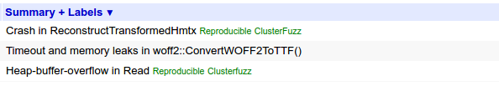
Custom options
fuzzer_test("convert_woff2ttf_fuzzer") { sources = [ "convert_woff2ttf_fuzzer.cc", ] deps = [ "//third_party/woff2:woff2_dec", ] seed_corpus = "//testing/libfuzzer/fuzzers/woff2_corpus" libfuzzer_options = [ "max_len=803500" ] }

Slide 51
Optimization [initial version]
#include "third_party/zlib/zlib.h"
// Entry point for LibFuzzer.
extern "C" int LLVMFuzzerTestOneInput(const unsigned char *data, size_t size) {
uint8_t buffer[1024 * 1024] = { 0 };
size_t buffer_length = sizeof(buffer);
if (Z_OK != uncompress(buffer, &buffer_length, data, size)) {
return 0;
}
return 0;
}

Slide 52
Optimization [initial version]
#include "third_party/zlib/zlib.h"
// Entry point for LibFuzzer.
extern "C" int LLVMFuzzerTestOneInput(const unsigned char *data, size_t size) {
uint8_t buffer[1024 * 1024] = { 0 };
size_t buffer_length = sizeof(buffer);
if (Z_OK != uncompress(buffer, &buffer_length, data, size)) {
return 0;
}
return 0;
}

Slide 53
Optimization [why you did that?]
#include "third_party/zlib/zlib.h"
// Entry point for LibFuzzer.
extern "C" int LLVMFuzzerTestOneInput(const unsigned char *data, size_t size) {
const int NUM_ITEMS = 1024 * 1024;
const int BUF_SIZE = NUM_ITEMS * sizeof(uint8_t);
uint8_t *buffer = new uint8_t[NUM_ITEMS];
uLongf buffer_length = (uLongf)BUF_SIZE;
memset(buffer, 0, BUF_SIZE);
if (Z_OK != uncompress(buffer, &buffer_length, data, static_cast<uLong>(size))) {
delete[] buffer;
return 0;
}
delete[] buffer;
return 0;
}

Slide 54
Optimization [reanimation]
#include "third_party/zlib/zlib.h"
// Entry point for LibFuzzer.
extern "C" int LLVMFuzzerTestOneInput(const unsigned char *data, size_t size) {
const int NUM_ITEMS = 1024 * 1024;
const int BUF_SIZE = NUM_ITEMS * sizeof(uint8_t);
uint8_t *buffer = new uint8_t[NUM_ITEMS];
uLongf buffer_length = (uLongf)BUF_SIZE;
memset(buffer, 0, BUF_SIZE);
if (Z_OK != uncompress(buffer, &buffer_length, data, static_cast<uLong>(size))) {
delete[] buffer;
return 0;
}
delete[] buffer;
return 0;
}

Slide 55
Optimization [reanimation]
#include "third_party/zlib/zlib.h"
static Bytef buffer[256 * 1024] = { 0 };
// Entry point for LibFuzzer.
extern "C" int LLVMFuzzerTestOneInput(const unsigned char *data, size_t size) {
uLongf buffer_length = static_cast<uLongf>(sizeof(buffer));
const int BUF_SIZE = NUM_ITEMS * sizeof(uint8_t);
uint8_t *buffer = new uint8_t[NUM_ITEMS];
uLongf buffer_length = (uLongf)BUF_SIZE;
memset(buffer, 0, BUF_SIZE);
if (Z_OK != uncompress(buffer, &buffer_length, data, static_cast<uLong>(size))) {
delete[] buffer;
return 0;
}
delete[] buffer;
return 0;
}

Slide 56
Optimization [final version]
#include "third_party/zlib/zlib.h"
static Bytef buffer[256 * 1024] = { 0 };
// Entry point for LibFuzzer.
extern "C" int LLVMFuzzerTestOneInput(const uint8_t* data, size_t size) {
uLongf buffer_length = static_cast<uLongf>(sizeof(buffer));
if (Z_OK != uncompress(buffer, &buffer_length, data, static_cast<uLong>(size))) {
return 0;
}
return 0;
}

Slide 57

Guess performance difference?

Slide 58
Guess performance difference?
remove memset() for 1MB heap buffer -> ~5x

Slide 59
Guess performance difference?
remove memset() for 1MB heap buffer -> ~5x
move 1MB heap buffer to the stack -> ~2x

Slide 60
Guess performance difference?
remove memset() for 1MB heap buffer -> ~5x
move 1MB heap buffer to the stack -> ~2x
use 256KB instead of 1Mb on the stack -> ~3x

Slide 61
Guess performance difference?
remove memset() for 1MB heap buffer -> ~5x
move 1MB heap buffer to the stack -> ~2x
use 256KB instead of 1Mb on the stack -> ~3x
move 256KB buffer from stack to global -> ~2x

Slide 62
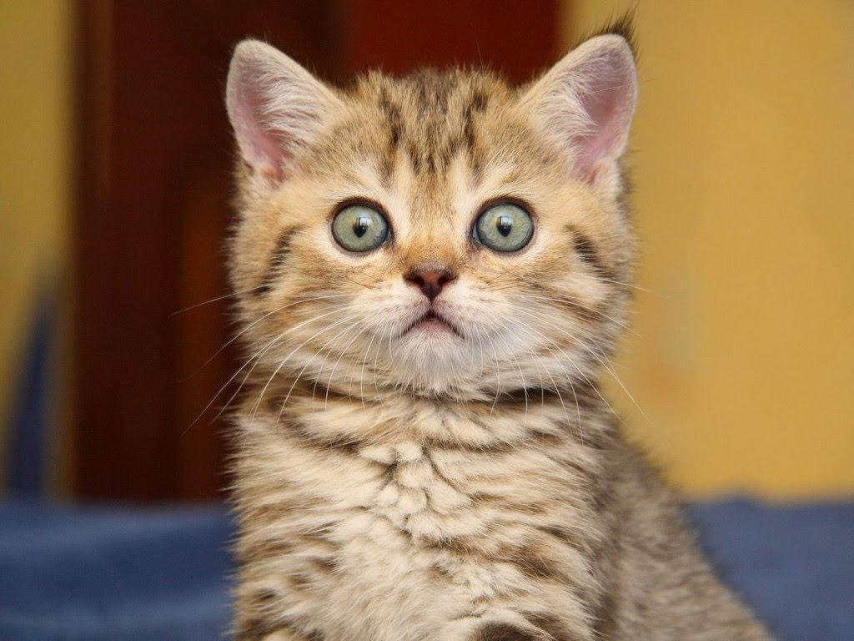

Guess performance difference?
remove memset() for 1MB heap buffer -> ~5x
move 1MB heap buffer to the stack -> ~2x
use 256KB instead of 1Mb on the stack -> ~3x
move 256KB buffer from stack to global -> ~2x
53x

Slide 63
Chromium integration
Homework assignment

Slide 64
Fuzz target (== target function)
#include "libxml/parser.h"
extern "C" int LLVMFuzzerTestOneInput(const uint8_t *data, size_t size) {
auto doc = xmlReadMemory(data, size, "noname.xml", NULL, 0);
if (doc) {
xmlFreeDoc(doc);
}
return 0;
}
https://chromium.googlesource.com/chromium/src/+/master/testing/libfuzzer/README.md

Slide 65

Build configuration
fuzzer_test("libxml_xml_read_memory_fuzzer") { sources = [ "libxml_xml_read_memory_fuzzer.cc", ] deps = [ "//third_party/libxml:libxml", ] }
https://chromium.googlesource.com/chromium/src/+/master/testing/libfuzzer/README.md

Slide 66
Chrome Fuzzer Program
The Chrome Fuzzer Program allows you to run fuzzers on Google hardware at Google scale across thousands of cores. You receive 100% of the reward value for any bugs found by your fuzzer plus a bonus $500, provided the same bug was not found by one of our fuzzers within 48 hours. There are two ways to participate:
libFuzzer
ClusterFuzz
https://www.google.com/about/appsecurity/chrome-rewards/index.html#fuzzerprogram

Slide 67

Chrome Fuzzer Program
https://www.google.com/about/appsecurity/chrome-rewards/index.html#fuzzerprogram

Slide 68
How to start [1/2]
Find a function with raw data input controlled by external source (user, server, etc)
First version of the fuzzer is ready, let’s fuzz!
Chose “entry point”
LLVMFuzzerTestOneInput()
Done
Write a target function which feeds fuzzer’s data into function chosen to fuzz

Slide 69
How to start [2/2]
Find a function with raw data input controlled by external source (user, server, etc)
First version of the fuzzer is ready, let’s fuzz!
Use existing tests
LLVMFuzzerTestOneInput()
Done
Replace testing input with data provided by LibFuzzer and wrap it into target function

Slide 70
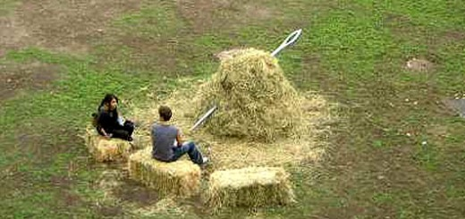
Q & A
Thank you!
mmoroz@chromium.org
Twitter: @dor3s
Telegram: @dor1s
‹#›

